Slide 1
Intro - New Clearing Platform B3 - Risk Module
February 2025

Slide 2
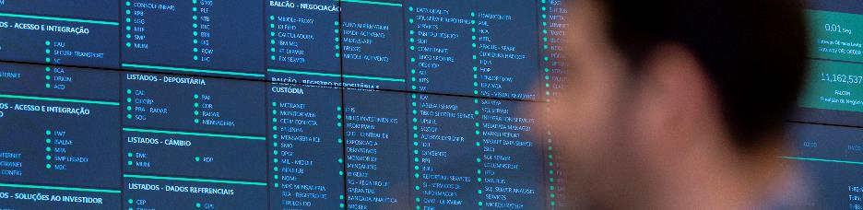
New Clearing Platform B3 - Risk Module
B3 and NASDAQ partnership
In July 2023, B3 and NASDAQ formed a partnership to develop a new Clearing platform. The development aims to create a new system that is more scalable, agile, secure, and flexible, called Nasdaq Real Time Clearing (NRTC), which will replace the current Real Time Clearing (RTC) system
The partnership aims not only for technological modernization but also to improve the customer experience by placing them at the center of the system's development.
Implementation Plan:
The implementation of the NRTC will be carried out in modules..
The Risk module of the NRTC will be the first to be delivered and the only one to be impacted at this moment.. The plan to announce the mandatory certification dates and go-live will be made available in June 2025.

Slide 3

New Clearing Platform B3 - Risk Module
Relevant improvements:
Decrease in the time for cyclical calculating risk, which currently takes around 18 minutes. New intraday risk queries; Better usability of the risk simulator; Better usability of the position transfer reallocation monitor; Implementation of reported improvements mapped in the current system (RTC).
Discontinuation:
The segregated risk calculation, which disregards master accounts and their sub-accounts, will be discontinued. We emphasize that the consolidated risk calculation will remain unchanged.

Slide 4
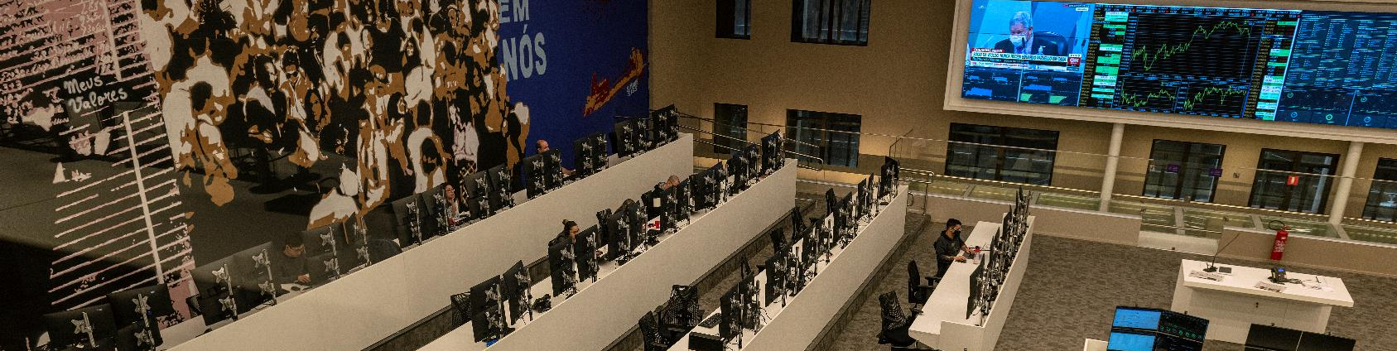
New Clearing Platform B3 - Risk Module
RTC screens that will be migrated in the risk module:
Intraday Risk Monitor;
Position Assessment Risk Monitor;
Risk Simulator.
What will not be impacted:
Intraday risk messaging and files: BVBG.034; BVBG.032; BVBG.092; bvmf.085; bvmf.086; bvmf.102; Maximum Theoretical Margin File: BVBG.030; Risk Simulation Messaging and Files: BVBG.035; BVBG.036; BVBG.100; BVBG.093; BVBG.101; BVBG.094; bvmf.108; bvmf.109; bvmf.208; bvmf.209; bvmf.210; bvmf.211;
SINACOR and the collateral files (NGA), such as BVBG.076, BVBG.078, and BVBG.080, will also not be impacted.
The screens will be accessed through the CVA system.
1 2

Slide 5

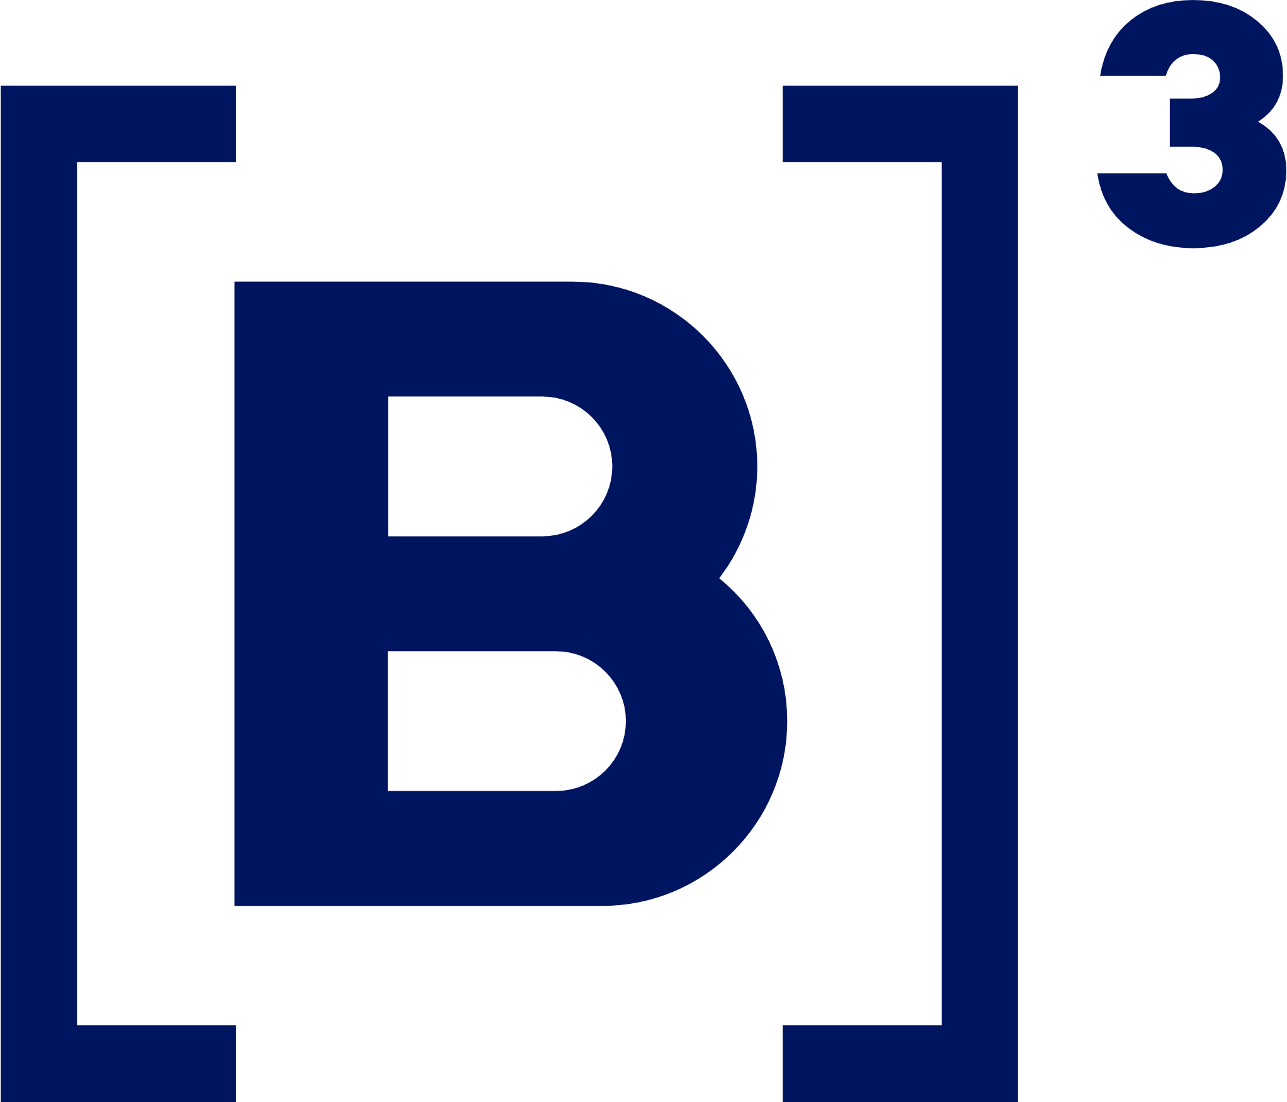
TKS!

